Slide 1


Organization Structure
(25CPE4602)
Lecture 3
Dr. Zahraa Ismail

Slide 2
Selection Criteria
Financial Criteria:
Payback.
Net present value (NPV).
Nonfinancial Criteria:
Projects of strategic importance to the firm.
Two Multi-Criteria Selection Models:
Checklist Models.
Multi-Weighted Scoring Models.

Slide 3
Financial Criteria: The Payback Model
Pavback Model:
Measures time project will take to qet back project investment.
Desires shorter paybacks.
It is simplest and most widely used model.
Emghasizes cash flows which is a key factor in business.
Pavback Formula is:
_{Payback period (yrs) =} Estimated project cost
Annual savings
Limitations of Pavback Method:
Does not consider profitability.
lqnores time value of money (inflation).
Assumes cash inflows durinq investment period (and not bevond, such as real annual project expenses).
Notes:
Key Concepts
Payback Period: The time required for cash inflows from an investment to equal the initial investment. It is usually expressed in years.
Cumulative Cash Flow: The running total of cash inflows over time, which helps in determining when the initial investment is recovered.
Payback Period Calculation
Steps:
Identify Initial Investment: Determine the total upfront cost of the project.
Estimate Annual Cash Inflows: Predict the annual cash inflows expected from the investment.
Calculate Cumulative Cash Flow: Track the cumulative cash flow for each year until it equals or exceeds the initial investment.
Determine Payback Period: The year in which the cumulative cash flow equals the initial investment is the payback period.
يقيس هذا النموذج المدة التي سيستغرقها المشروع لاستعادة استثماره. يهدف إلى تحقيق فترات استرداد أقصر. يُعد هذا النموذج أبسط النماذج وأكثرها استخدامًا. يُركز على التدفقات النقدية، وهي عامل أساسي في الأعمال.
قيود طريقة بافباك: لا تأخذ في الاعتبار الربحية. تأخذ في الاعتبار القيمة الزمنية للنقود (التضخم). تفترض تدفقات نقدية خلال فترة الاستثمار (وليس بعدها، مثل النفقات السنوية الفعلية للمشروع).

Slide 4
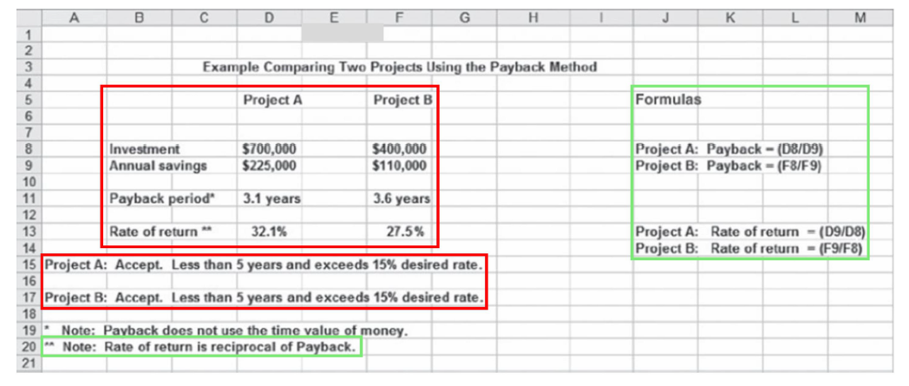
Example 1: Comparing Two Projects Using Payback Method

Slide 5
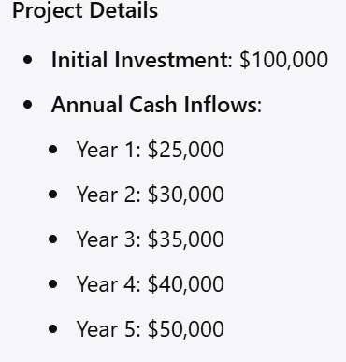
Example 2

Slide 6
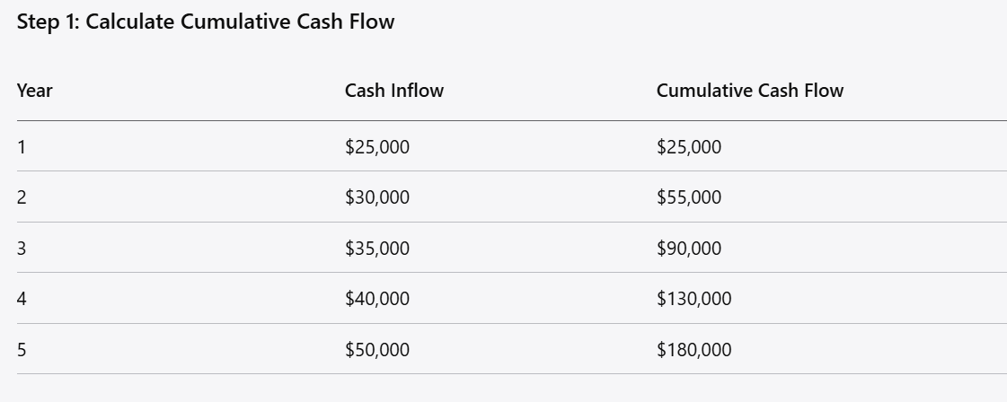
Solution

Slide 7
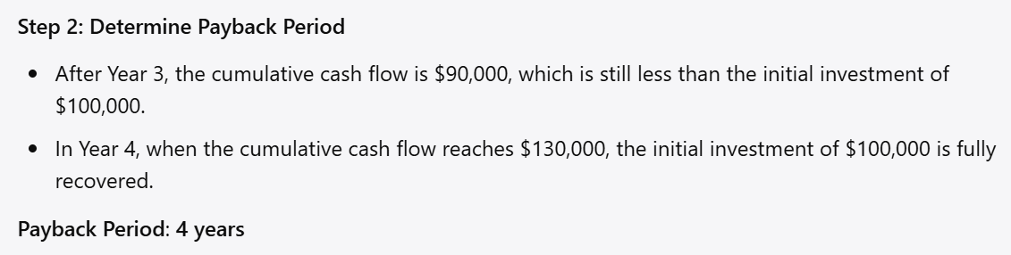
Solution
Notes:
Advantages of the Payback Model
Simplicity: Easy to understand and calculate.
Risk Assessment: Helps assess liquidity and risk by showing how quickly an investment can be recovered.
Disadvantages of the Payback Model
Ignores Time Value of Money: Does not account for the time value of money, which can lead to misleading results.
Ignores Cash Flows After Payback: Does not consider cash inflows that occur after the payback period, missing the overall profitability of the project.
No Profitability Measure: It does not provide a measure of profitability, only the recovery time.
Conclusion
The payback model is a useful tool for quickly assessing the financial viability of an investment, especially for businesses focused on liquidity and short-term cash flow. However, it should be used in conjunction with other financial metrics, such as NPV and IRR, for a comprehensive evaluation of investment opportunities.

Slide 8
Payload
Definition: Payload refers to the effective output or returns generated by a project relative to its costs. It can be expressed as a ratio or in absolute terms, indicating efficiency in generating returns.
Importance:
A higher payload ratio suggests better performance in utilizing resources.
It helps in comparing projects with different scales or operational efficiencies.

Slide 9
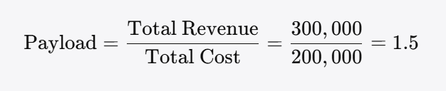
Example 1: Payload
If a project with a total cost of $200,000 generates revenues of $300,000, the payload can be calculated as:
This indicates that for every dollar spent, the project generates $1.50 in revenue.

Slide 10



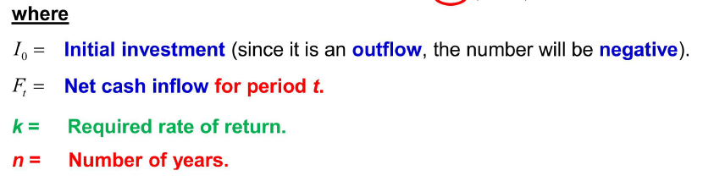
Financial Criteria: Net Present Value (NPV)
Net Present Value (NPV):
Uses management's minimum desired rate of return to compute present value of all net cash inflows.
Prefers positive NPV to negative NPV.
Desires higher positive NPVs.
Is more realistic because it considers time value of money, cash flows, and profitability.
NPV Formula is:
Notes:
القيمة الحالية الصافية (NPV) التعريف: تُمثل القيمة الحالية الصافية الفرق بين القيمة الحالية للتدفقات النقدية الداخلة والخارجة على مدى فترة زمنية. وتُساعد في تقييم ربحية أي استثمار أو مشروع. الأهمية: تشير القيمة الحالية الصافية الموجبة إلى أنه من المتوقع أن يُدرّ المشروع سيولة نقدية تفوق تكلفته. وتُراعي القيمة الزمنية للنقود، مُدركةً أن قيمة الدولار اليوم أعلى منها في المستقبل.
Definition: NPV represents the difference between the present value of cash inflows and outflows over a period of time. It helps in assessing the profitability of an investment or project.
Importance:
Positive NPV indicates that the project is expected to generate more cash than it costs.
It accounts for the time value of money, recognizing that a dollar today is worth more than a dollar in the future.

Slide 11
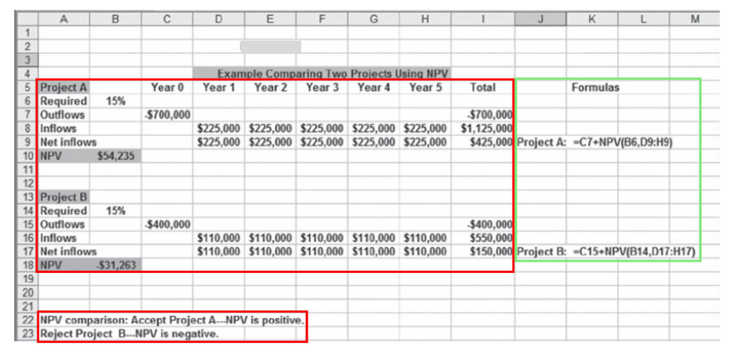
Example 1: Comparing Two Projects Using NPV Method

Slide 12
Example 2:
Suppose a project requires an initial investment of $100,000 and is expected to generate cash inflows of $30,000 annually for five years. If the discount rate is 10%, the NPV is calculated as:
NPV =
This results in a positive or negative NPV, guiding the decision.

Slide 13
Example 3:
Imagine a company is considering investing in a new project. The project requires an initial investment and is expected to generate cash inflows over several years.
Project Details
Initial Investment: $100,000
Annual Cash Inflows:
  Year 1: $30,000
  Year 2: $35,000
  Year 3: $40,000
  Year 4: $45,000
  Year 5: $50,000
Discount Rate: 10%

Slide 14
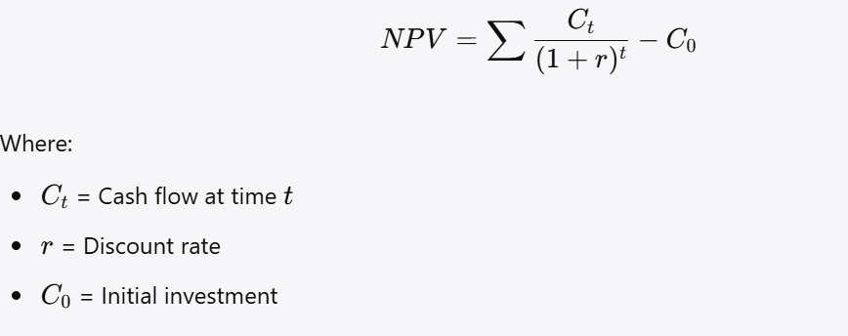
Calculate NPV
Step 1: Calculate NPV
Formula:
NPV=

Slide 15
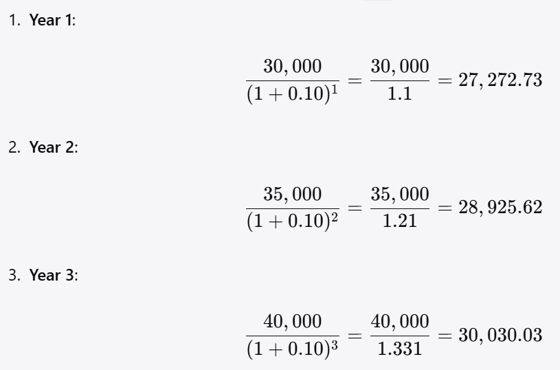
Solution

Slide 16
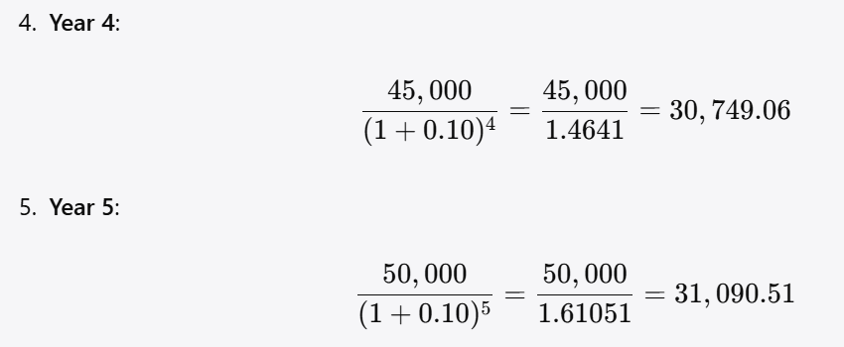
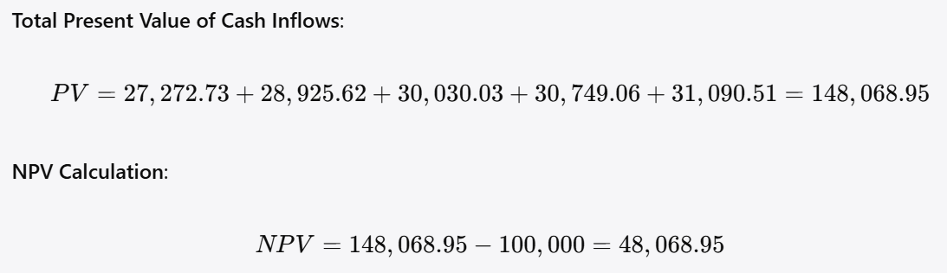

Slide 17
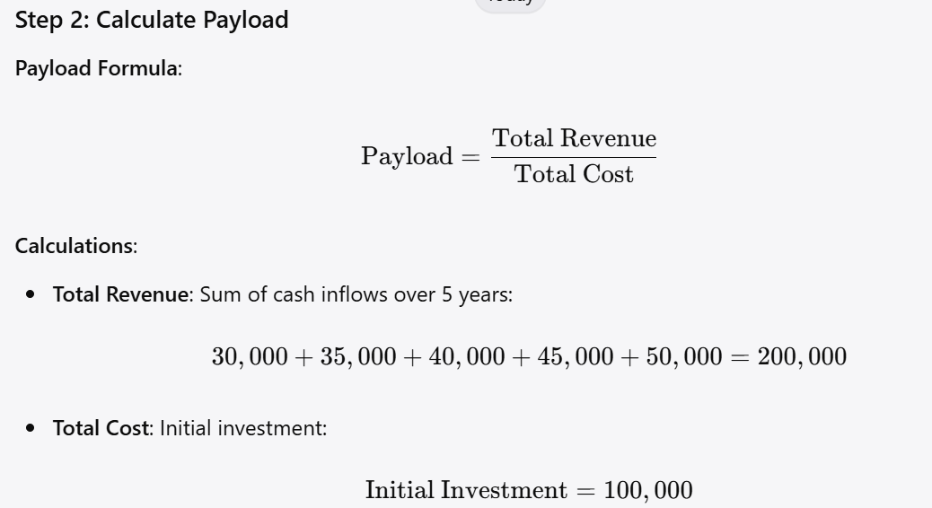
Calculate payload

Slide 18
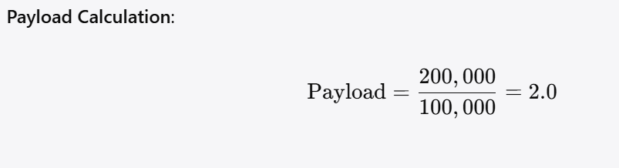
Solution
Summary of Results
NPV: $48,068.95 (indicating the project is expected to generate value)
Payload: 2.0 (indicating that for every dollar spent, the project generates $2 in revenue)
This example clearly shows how to calculate both NPV and payload, providing insight into the project's financial viability.

Slide 19
Nonfinancial Criteria
To cagture larger market share.
To make it difficult for competitors to enter market.
To develop an enabler product, which by its introduction will increase sales in more profitable products.
To develop core technology that will be used in next- generation products.
To reduce dependency on unreliable suppliers.
Notes:
الاستحواذ على حصة سوقية أكبر. صعّب دخول المنافسين إلى السوق. تطوير منتج مُمَكِّن، يُسهم طرحه في زيادة مبيعات المنتجات الأكثر ربحية. تطوير تقنيات أساسية تُستخدم في منتجات الجيل التالي. تقليل الاعتماد على الموردين غير الموثوقين
1. Strategic Alignment
Definition: Measures how well a project supports the overall strategic direction of the organization.
Importance: Projects that align with strategic goals are more likely to receive support and resources.
Considerations:
Does the project support long-term goals?
How does it fit into the company's mission or vision?
2. Risk Assessment
Definition: Involves identifying and evaluating potential risks associated with a project.
Importance: Understanding risks helps in developing mitigation strategies and ensuring project viability.
Types of Risks:
Market Risk: Changes in market conditions that could affect demand.
Operational Risk: Risks arising from internal processes or systems.
Technological Risk: Risks related to the technology used in the project.
3. Stakeholder Impact
Definition: Evaluates how the project affects various stakeholders.
Importance: Understanding stakeholder perspectives can enhance support and reduce resistance.
Considerations:
Employee impact (job security, morale).
Customer impact (satisfaction, loyalty).
Community impact (environmental, economic).
4. Environmental and Social Impact
Definition: Assesses the sustainability and social implications of a project.
Importance: Projects that demonstrate social responsibility can enhance reputation and compliance with regulations.
Considerations:
Environmental sustainability (carbon footprint, resource use).
Social equity (impact on different community groups).
.

Slide 20
Two Multi-Criteria Selection Models
Checklist Model:
Uses a list of questions to review potential projects and to determine their acceptance or rejection.
Advantaqe: allows greater flexibility in selectinq among many different types of projects.
Disadvantaqes:
\• Fails to answer importance or value of a potential project to organization.
\• Does not allow for comparison with other potential projects.

Slide 21
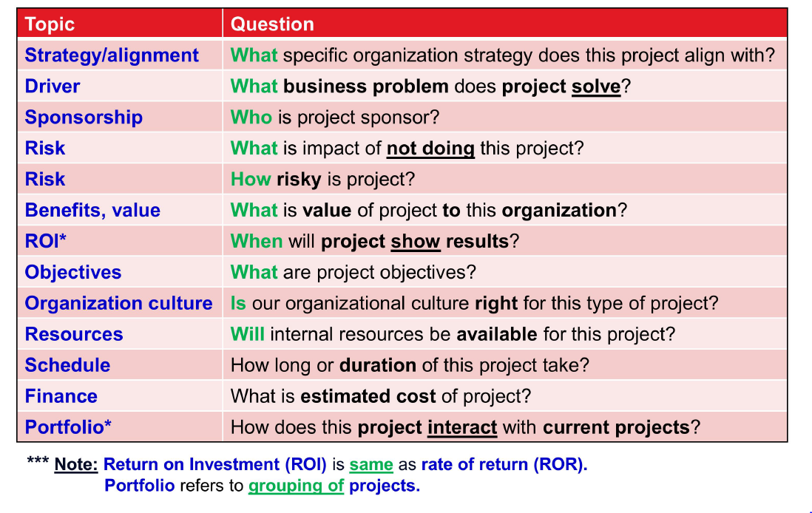
Checklist Model: Sample Selection Questions used in Practice

Slide 22
Two Multi-Criteria Selection Models
Uses several weighted selection criteria to evaluate project proposals.
Includes qualitative and/or quantitative criteria.
Allows for comparison with other potential projects.

Slide 23
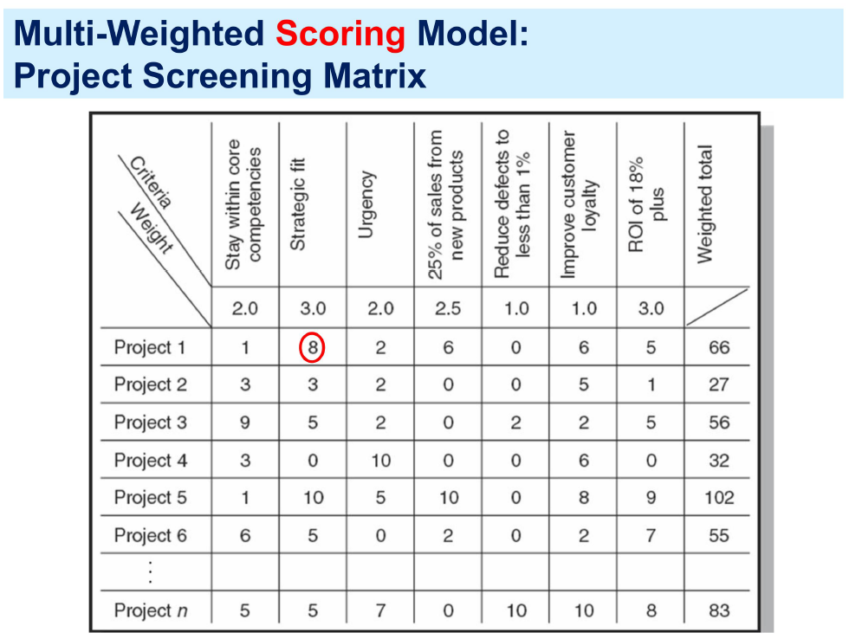
Notes:
Weighted Scoring Model
Definition: A simple and effective method for evaluating alternatives based on multiple criteria.
Steps:
Identify Criteria: List all criteria relevant to the decision.
Assign Weights: Allocate weights based on the relative importance of each criterion (total should equal 1).
Score Alternatives: Rate each alternative based on how well it meets each criterion (e.g., on a scale of 1 to 10).
Calculate Scores: Multiply scores by weights and sum to get a total score for each alternative.
Rank Alternatives: Rank the alternatives based on their total scores.
Example:
Suppose you’re evaluating three projects based on criteria like cost, benefit, and risk. You assign weights (0.4 for cost, 0.4 for benefit, 0.2 for risk), score each project, and calculate the total scores to decide which project to pursue.
Analytic Hierarchy Process (AHP)
Definition: AHP is a structured method for organizing and analyzing complex decisions based on mathematics and psychology.
Steps:
Define the Problem: Clearly state the decision-making problem.
Structure the Hierarchy: Break down the problem into a hierarchy of criteria and sub-criteria.
Pairwise Comparisons: Compare each criterion against others to establish priorities.
Calculate Weights: Use mathematical calculations to derive weights for each criterion.
Aggregate Results: Combine the weighted scores of alternatives to determine the best option.
Example:
If you are selecting a new software system, criteria might include cost, usability, and support. Each of these can be broken down further, and then pairwise comparisons made to establish a priority scale.

Slide 24
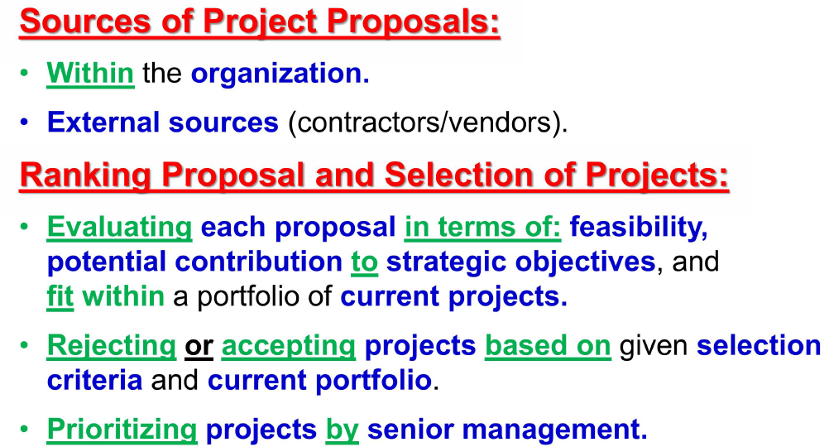
Aspects of applying a Selection Model

Slide 25
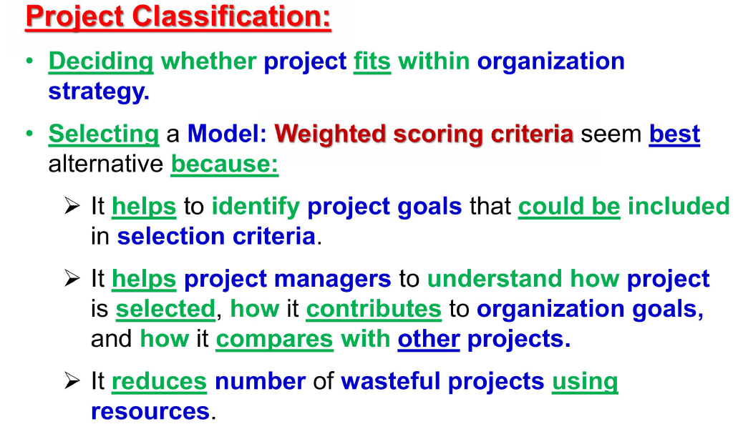
Aspects of applying a Selection Model

Slide 26
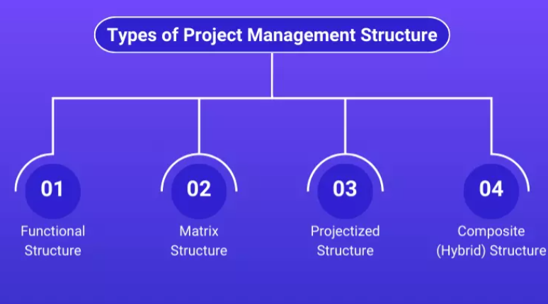






Project Management Structures
Dedicated project teams
Matrix structure
Functional Organization
Notes:
Project management structures refer to the framework within which projects are organized and managed in an organization. These structures define the roles, responsibilities, authority, and relationships between project managers, teams, and other stakeholders. The key types of project management structures are:
‍
Functional Structure: Departments are organized by specialization (e.g., marketing, finance, operations), and project managers have limited authority. The focus is on efficiency within specialized functions, but cross-functional collaboration can be challenging.
Matrix Structure: A hybrid approach that blends functional and projected models. Project managers share authority with functional managers, and team members typically report to both. It allows for better resource allocation and flexibility but can create conflicts due to dual reporting lines.
Projectized Structure: In this model, the organization is centered around projects. Project managers have full control over resources, decision-making, and team members, making it ideal for project-driven organizations. It allows for more autonomy but can lead to duplication of efforts across projects.
. Functional Structure
Description: In a functional structure, the project team is organized according to different functions or departments (e.g., marketing, finance, engineering).
Characteristics:
Team members report to their functional managers.
Project managers have limited authority and mainly coordinate activities across functions.
Advantages:
Clear lines of authority within functional departments.
Efficient use of specialized resources.
Disadvantages:
Potential for poor communication between departments.
Slow decision-making due to reliance on functional managers.
2. Projectized Structure
Description: In a projectized structure, teams are organized around specific projects. Team members report directly to the project manager.
Characteristics:
Project managers have full authority over the project and resources.
Teams are often formed for the duration of the project.
Advantages:
Clear focus on project objectives.
Enhanced communication and collaboration among team members.
Disadvantages:
Inefficient resource utilization if team members are only needed for short-term projects.
Team members may lack a sense of belonging to their functional departments.
3. Matrix Structure
Description: A matrix structure combines functional and projectized structures, allowing for more flexibility and balanced authority.
Characteristics:
Team members report to both functional managers and project managers.
Resources can be shared across multiple projects.
Types:
Weak Matrix: Functional managers have more authority, and project managers have limited power.
Balanced Matrix: Authority is shared equally between functional and project managers.
Strong Matrix: Project managers have more authority than functional managers.
Advantages:
Efficient resource allocation across projects.
Improved communication and collaboration.
Disadvantages:
Potential for conflict between project and functional managers.
Confusion over reporting relationships.
4. Composite Structure
Description: A composite structure is a hybrid that combines elements from various project management structures based on the organization's needs.
Characteristics:
Different projects or departments may use different structures.
Flexibility to adapt to the specific context of each project.
Advantages:
Tailored approach to project management.
Can leverage the strengths of various structures.
Disadvantages:
Complexity in management and coordination.
Potential inconsistency across projects.

Slide 27
Project Management Structures
Three different project management structures are:
Functional approach
  Functional organizations
Dedicated proiect teams
  Projectized organizations
Matrix structure
  Weak matrix
  Balanced matrix
  Strong matrix

Slide 28
Why is it Important?
The choice of project management structure is crucial because it directly impacts the efficiency, effectiveness, and success of projects. It determines how resources are allocated, how teams collaborate, and how decision-making is handled.
The right structure fosters clear communication, reduces conflicts, and ensures that projects are completed on time and within budget. By aligning the structure with organizational goals and project needs, companies can optimize performance, improve project delivery, and enhance overall organizational agility.

Slide 29
Functional Approach — Functional Organization
Functional Organization: uses Functional Approach to administer and complete projects.
Top management decides to implement project, and different segments of project are distributed to appropriate functional areas (e.s. departments).
Coordination is maintained through normal management channels.
Commonly used when one functional area plays dominant role in completinq project, or has dominant interest in success of project.
Notes:
This structure organizes employees based on their specialized functions or departments (e.g. marketing, finance, engineering); it’s ideal for organizations with well-defined departments and a focus on specializations. In a functional structure, centralized decision-making can slow project progress, particularly when multiple levels of approval are needed.
PROS: Functional structures create clear lines of authority within departments and allow employees to develop specialized expertise.
CONS: This structure can lead to silos and communication barriers between departments, and it may not be adaptable to changing project needs.
To mitigate potential challenges and maximize the effectiveness of a functional structure, you should promote cross-functional communication, clearly define roles and responsibilities, and empower project managers within your organization.

Slide 30

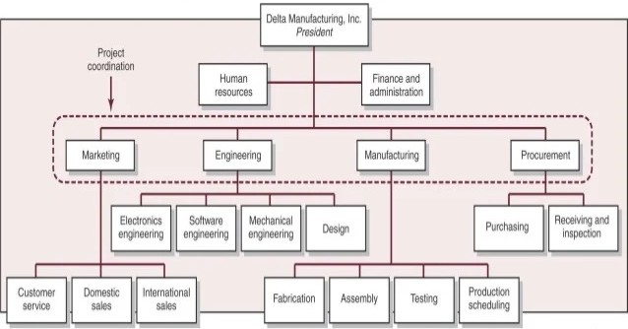
Functional Organization example (1/4)
Notes:
The Functional Organization groups workers based on their area of specialization. This structure is an extension of the Line Organization. The functional manager leads the team and manages all the operations or businesses.
The Functional Organization manager enforces directives within a clearly defined scope of authority. This concept originated with Fredrick W. Taylor.
Here you classify workers according to their functional roles and department. Some of the general departments under this are
Finance
HR
Sales
Customer service
Supply Chain, etc.,
The organization's head is the president, followed by the vice president, and the chain goes on. Furthermore, the leaders of departments foresee their departmental performance. So they collectively help the organization control quality and uniformity.
The structure positions departments vertically and disconnected from others. Hence the name “silos.” The department heads manage communication between the top management and his subordinates.
The project manager has a minimal role to play or may not have a designated position. Generally, you'll play the role of an expediter or work as a coordinator. While as a functional manager, you'll deal with
Budget allocation
Resource allocation, and
Decision making
This type of organization is suitable for manufacturing or engineering companies. It supports ongoing operations and practices for product development.
Advantages
Some of the main benefits of this type of organization are:
1) It groups employees based on functional skills for a higher degree of performance.
2) Employees have experience in the same field, resulting in higher output. Also, they deliver high-quality services and results.
3) Accountability is evident, as the roles and responsibilities are clearly defined.
4) Hierarchy is visible and no need for multiple reporting
5) No duplication of work as each department is different. Also, the job description is clear.
6) Career path for the staff is clear and visible
Disadvantages
1) Employees get bored with the routine and lose enthusiasm.
2) It limits the management skills of functional managers. Hence, they face restrictions on their growth path and remain specialists. So they're not prepared for top management posts.
3) Departments are more concerned with their departmental goals and therefore may be less responsive to the organization’s overall objectives.
4) Hiring costs are too high as high-skilled employees cost more.
5) It causes conflicts in making critical decisions as a result of bureaucratic hierarchy. Functional managers have full authority and may make arbitrary decisions

Slide 31
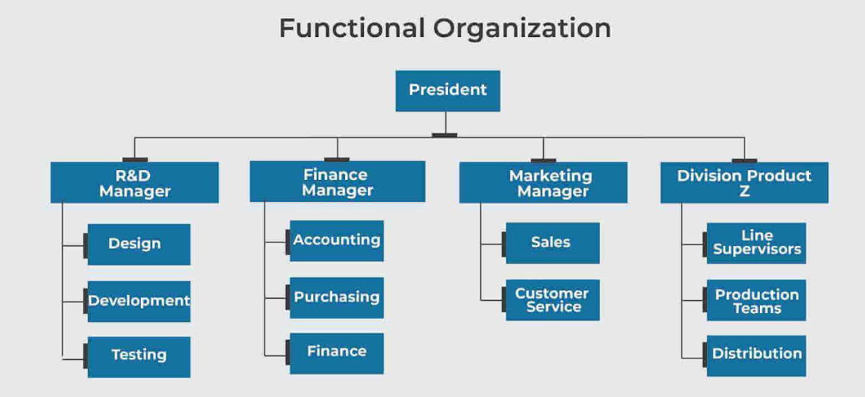
Functional Organization example (1/4)
Notes:
In a functional structure, the organization is divided into departments based on specific functions (e.g., marketing, finance, human resources, engineering). Each department has its functional manager, who oversees the operations and activities within that area.
‍
Project managers in this structure have limited authority and typically only oversee specific tasks or smaller projects within their functional area. Team members remain in their functional roles and report to their department heads.
‍
Advantages:
Clear specialization and expertise within each department.
Efficient use of resources within functional areas.
Suitable for stable environments with routine, repetitive projects.
‍
Disadvantages:
Limited collaboration across departments.
Project managers need more control and authority over resources and team members.
‍

Slide 32
Functional Organization (2/4)
Advantages
  No Change. Projects are completed within the basic functional structure of the parent organization.
  Flexibility. There is maximum flexibility in the use of staff. Appropriate specialists in different functional units can temporarily be assigned to work on the project and then return to their normal work. With a broad base of technical personnel available within each functional department, people can be switched among different projects with relative ease.
  In-Depth Expertise. If the scope of the project is narrow and the proper functional unit is assigned primary responsibility, then in-depth expertise can be brought to bear on the most crucial aspects of the project.
  Easy Post-Project Transition. Normal career paths within a functional division are maintained.
Notes:
Advantages
No Change. Projects are completed within the basic functional structure of the parent organization.
Flexibility. There is maximum flexibility in the use of staff. Appropriate specialists in different functional units can temporarily be assigned to work on the project and then return to their normal work. With a broad base of technical personnel available within each functional department, people can be switched among different projects with relative ease.
In-Depth Expertise. If the scope of the project is narrow and the proper functional unit is assigned primary responsibility, then in-depth expertise can be brought to bear on the most crucial aspects of the project.
Easy Post-Project Transition. Normal career paths within a functional division are maintained.

Slide 33
Functional Organization (3/4)
Disadvantages
  Lack of Focus. Each functional unit has its own core routine work to do; sometimes project responsibilities get pushed aside to meet primary obligations. This difficulty is compounded when the project has different priorities for different units.
  Poor Integration. There may be poor integration across functional units. Functional specialists tend to be concerned only with their segment of the project and not with what is best for the total project.

Slide 34
Functional Organization (4/4)
Disadvantages (cont.)
  Slow. It generally takes longer to complete projects through this functional arrangement. This is in part attributable to slow response time—project information and decisions have to be circulated through normal management channels. Furthermore, the lack of horizontal, direct communication among functional groups contributes to rework as specialists realize the implications of others’ actions after it occurs.
  Lack of Ownership. The motivation of people assigned to the project can be weak. The project may be seen as an additional burden that is not directly linked to their professional development or advancement. Furthermore, because they are working on only a segment of the project, professionals do not involve deeply with the project

Slide 35
Dedicated Project Teams (1/5)
At the other end of the structural spectrum is the creation of a dedicated project team. These teams operate as separate units from the rest of the parent organization.
Usually, a full-time project manager is designated to pull together a core group of specialists who work full time on the project.
The project manager recruits necessary personnel from both within and outside the parent company.
The subsequent team is physically separated from the parent organization and given marching orders to complete the project.
The main responsibility of traditional functional departments is to assist and support these project teams.
The interface between the parent organization and the project teams will vary.
7
Notes:
Projectized Structure
This structure is centered around projects, with project managers having significant authority over resources and decision-making for their projects. Teams are dedicated solely to projects; they’re disbanded once the project is complete. Projectized structures work best in industries such as consulting. This structure enhances decision-making speed and resource dedication, which is critical for fast-moving projects.
PROS: Projectized structures present a clear focus on project goals and efficient project execution.
CONS: This structure can have the potential for resource duplication across projects and may cause team members to feel isolated from their functional departments.
To mitigate potential challenges of a projectized structure, you can optimize resources, maintain connections with functional departments, and plan for post-project transitions.
Project organization is a temporary setup formed for specific projects. It's also called “projectized organizational structure.” The project manager assigned for the project is the head of this structure.
Once the project is complete, you may choose to dismantle this setup or move it to form a new project. In the case of a new project, the project manager might have to reshuffle the staff to fit the new plan. You’ll hire resources or specialists from different functional departments.
As a project manager, you can use allotted resources until completion and closeout. Albeit you're accountable for all the activities and timely completion of the project. In other words, you must spend based on the project budget.
The manager assigns clearly defined tasks to each of the team members, along with the complete schedule.
These types of organizations are useful when:
The project scope is complete, and objectives are clearly defined
The project is unique and independent
Advantages
1) Easy to communicate, hence can stay up to date
2) The team can have a strong sense of identity as all are working together to achieve a common goal
3) Manage resources efficiently and effectively
Disadvantages
1) No clear growth path for the team once the project gets completed
2) It's expensive because the organization dedicates all the specialists for one single project.

Slide 36
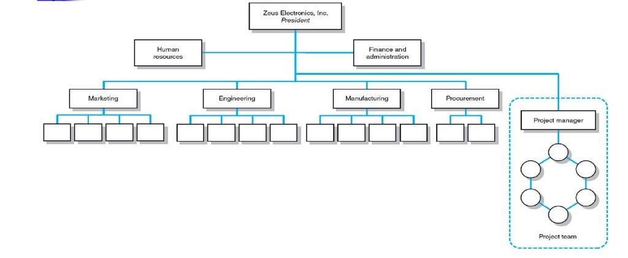
Dedicated Project Teams example (2/5)

Slide 37
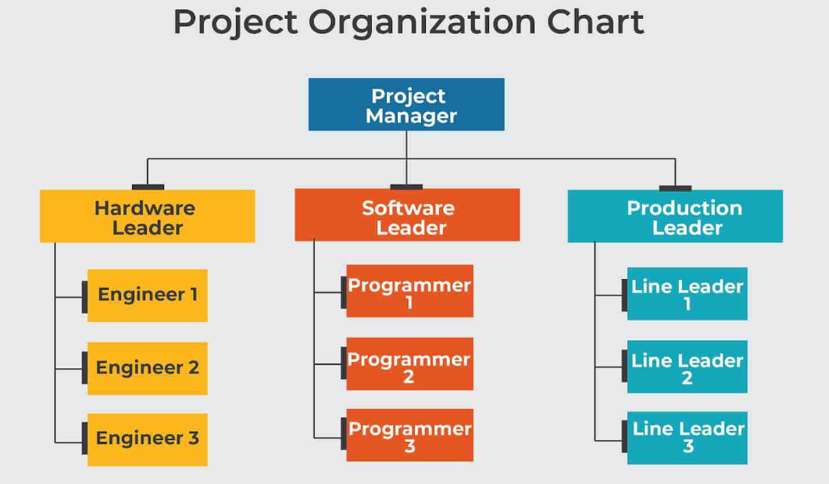
Dedicated Project Teams example(2/5)
Notes:
https://www.greycampus.com/blog/project-management/common-types-of-organizational-structures-in-project-management

Slide 38
Dedicated Project Teams (3/5)
Advantages:
  Simple: Other than taking away resources in the form of specialists assigned to the project, the functional organization remains intact with the project team operating independently.
  Fast: Projects tend to get done more quickly when participants devote their full attention to the project and are not distracted by other obligations and duties or by deferring up the hierarchy.
  Cohesive: A high level of motivation and cohesiveness often emerges within the project team. Participants share a common goal and personal responsibility toward the project and the team.
  Cross-Functional Integration. Specialists from different areas work closely together and, with proper guidance, become committed to optimizing the project, not their respective areas of expertise

Slide 39
Dedicated Project Teams (4/5)
Disadvantages
  Expensive: Not only have you created a new management position (project manager), but resources are also assigned on a full-time basis. This can result in duplication of efforts across projects and a loss of economies of scale.
  Internal strife: Sometimes dedicated project teams become an entity in their own right and conflict emerges between the team and the remainder of the organization. This divisiveness can undermine not only the integration of the eventual outcomes of the project into mainstream operations but also getting back of project team members
into their functional units once the project is completed.

Slide 40
Dedicated Project Teams (5/5)
Disadvantages (cont)
  Limited Technological Expertise. Creating self-contained teams inhibits maximum technological expertise being brought to bear on problems. Technical expertise is limited somewhat to the talents and experience of the specialists assigned to the project. While nothing prevents specialists from consulting with others in the functional division, the we–they syndrome and the fact that such help is not formally sanctioned by the organization discourage this from happening
  Difficult Post-Project Transition. Assigning full-time personnel to a project creates the dilemma of what to do with personnel after the project is completed. If other project work is not available, then the transition back to their original functional departments may be difficult because of their prolonged absence and the need to catch up with recent developments in
their functional area
11
Notes:
In a projected structure, the organization is designed around projects, and project managers have full authority over their projects. Project managers control the resources, budget, and team members, and the organization is often organized into project teams rather than functional departments. This structure is typically used by organizations that primarily focus on delivering projects, such as construction firms or consulting agencies.
‍
Advantages:
Full authority and autonomy for project managers.
A clear focus on project goals and deliverables.
Faster decision-making since project managers control resources and processes.
‍
Disadvantages:
Resource duplication, as each project may require separate resources or teams.
Lack of functional specialization and knowledge-sharing between projects.
This can lead to inefficiencies when multiple projects are running simultaneously.

Slide 41
Matrix Arrangement (1/5)
One of the biggest management innovations to emerge in the past 40 years
It is a hybrid organizational form in which a horizontal project management structure is “overlaid” on the normal functional hierarchy.
Usually, there are two chains of command, one along functional lines and the other along project lines. Project participants report simultaneously to both functional and project managers
Companies apply this matrix arrangement in a variety of different ways. Some organizations set up temporary matrix systems to deal with specific projects, while “matrix” may be a permanent fixture in other organizations.
Project participants are assigned to the project on a part-time or full-time basis, depending on the project’s needs during various phases of the project.
The matrix structure is designed to optimally utilize resources by having individuals work on multiple projects as well as being capable of performing normal functional duties
12
Notes:
The structure combines elements of both functional and projectized structures, giving more authority to project managers while maintaining functional leadership. Employees report to both a functional leader and project manager, creating a grid-like reporting structure. However, project managers may face difficulty in balancing authority between functional and project roles, which can create resource allocation and communication challenges.
PROS: Matrix structures can enhance flexibility and leverage specialized skills across multiple projects.
CONS: This structure can lead to conflicts in authority and communication challenges due to dual reporting lines.
For a matrix structure to be successful, you’ll want to clearly define roles, responsibilities and authority, foster a collaborative culture, and implement effective communication mechanisms.

Slide 42












































































Matrix Arrangement example (2/5)
Zeta Manufacturing Inc.
President
Human Resources
Marketing
Director of Projects
Engineering
Manufacturing
Assembly Testing Quality
Marketing
Design Engineering
Electronics Engineering
Software Engineering
Mechanical Engineering
Technical documentation
Customer service
Domestic Sales
International sales
Project A Manager
1
2
1/2
1
2
1
2
Project B Manager
3
1
1
1
1
1
1
1
2
1
1
Project C Manager
1
2
2
1/2
13
Notes:
This one is the combination of a projectized and functional organization. This hybrid organization overcomes the limitations of each organization. Here, both the functional and project managers share their respective authorities.
Project managers are generally responsible for
Overall integration
Project planning
Execution of the project, and
Completion of project activities
All activities must be done using the assigned resources.
The functional managers are concerned with the operational aspects of the project. They’re also responsible for providing technical guidance.
The functional staff specializes in the skills required for the project. Though project managers manage the project staff, functional managers control the process.
This type of organization is most useful when workers must share available resources. The combination achieves high efficiency and better usage of available resources. Also, they adapt better to the changing trends.
You can further classify the Matrix Organization into
Balanced
Strong and
Weak
The authority level that both functional and project managers share determines its strength.
Advantages
1) It helps in sharing resources efficiently
2) Decision making is balanced and flexible
3) Staff members can communicate with each other across boundaries
4) Pleasant environment
5) It has a clear career graph and job security; hence, members would be more loyal to the organization
Disadvantages
1) The dual reporting structure add confusion and results in conflicts
2) Create issues when there is no coordination between functional and project managers
3) Resources may be under-utilized if you don't assign them with skill-related tasks
4) Costly to maintain as it has many managers
5) You need to maintain resources throughout the project, no matter how long it takes
You may also like: 5 Trends That Are Shaping Project Management Plans in 2021

Slide 43
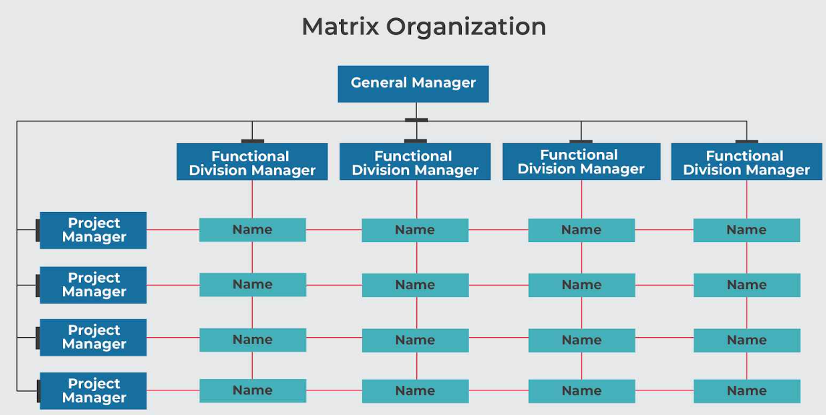
Matrix Arrangement example(2/5)
Notes:
https://www.greycampus.com/blog/project-management/common-types-of-organizational-structures-in-project-management
https://www.greycampus.com/blog/project-management/5-trends-that-are-shaping-project-management-plans-in-2021

Slide 44
Matrix Arrangement (3/5)
Advantages
  Efficient: Resources can be shared across multiple projects as well as within functional divisions. Individuals can divide their energy across multiple projects on an as-needed basis. This reduces duplication as opposed to dedicated project teams.
  Strong Project Focus: A stronger project focus is provided by having a formally designated project manager who is responsible for coordinating and integrating contributions of different units.
  Easier Post-Project Transition: Because the project organization is overlaid on the functional divisions, specialists maintain ties with their functional group, so they have a homeport to return to once the project is completed.
  Flexible: Matrix arrangements provide for flexible utilization of resources and expertise within the firm.
14
Notes:
The matrix structure is a hybrid model that combines elements of both functional and projected structures. In this setup, team members report both to their functional managers and the project manager.
‍
The project manager has authority over project-related activities, while functional managers oversee the technical expertise and resources required for the project.
‍
Matrix structures can be classified into three types based on the level of authority the project manager holds:
‍
Weak Matrix: The project manager has limited authority, and functional managers retain most control.
Balanced Matrix: Project managers and functional managers share authority and responsibilities.
Strong Matrix: Project managers have more authority and control over resources and decision-making, similar to a projected structure.
‍
Advantages:
Better resource sharing and flexibility.
Encourages collaboration between departments.
Allows for expertise from different functional areas to be integrated into the project.
‍
Disadvantages:
Potential for conflict between functional managers and project managers due to shared authority.
A simple reporting structure can lead to clarity and communication.

Slide 45
Matrix Arrangement (4/5)
Disadvantages
  Complex: It is more complicated and the creation of multiple bosses represents a radical departure from the traditional hierarchical authority system.
  Long time for system implementation: It is said that it takes (3 – 5) years for a matrix system to fully mature.
  Slow: In theory, the presence of a project manager to coordinate the project should accelerate the completion of the project. In practice, decision making can get bogged down as agreements have to be managed across multiple functional groups.
15

Slide 46
Matrix Arrangement (5/5)
Disadvantages (cont.)
  Stressful: Matrix management violates the management principle of unity of command. Project participants have at least two bosses: their functional head and one or more project managers. Working in a matrix environment can be extremely stressful. Imagine what it would be like to work in an environment in which you are being told to do three conflicting things by three different managers.
  Infighting and Dysfunctional Conflict: The matrix approach is subjected to tension between functional managers and project managers. Any situation in which equipment, resources, and people are being shared across projects and functional activities lends itself to conflict and competition for rare resources. Infighting can occur among project managers, who are primarily interested in what is best for their project.
16

Slide 47
Different Matrix Forms (1/3)
Weak matrix:
  Very similar to a functional approach with the exception that there is a formally designated project manager responsible for coordinating project activities.
  Functional managers are responsible for managing their segment of the project; while the project manager basically acts as a staff assistant who draws the schedules and checklists, collects information on status of work, and facilitates project completion.
  The project manager has indirect authority to expedite and monitor the project; while functional managers call most of the shots and decide who does what and when the work is completed.
Notes:
Weak Matrix:
\• Very similar to a functional approach with excegtion that there is a formally designed project manager responsible for coordinatinq project activities.
\• Proiect mana er acts as a staff assistant who:
sets schedules and checklists,
collects information on status of work, -0
facilitates project completion.
\• Functional mana ers mana g their segment of project.

Slide 48
Different Matrix Forms (2/3)
Balanced matrix:
  The classic matrix in which the project manager is responsible for defining what needs to be accomplished while the functional managers are concerned with how it will be accomplished.
  More specifically, the project manager establishes the overall plan for completing the project, integrates the contribution of the different disciplines, sets schedules, and monitors progress.
  The functional managers are responsible for assigning personnel and executing their segment of the project according to the standards and schedules set by the project manager.
  The merger of “what and how” requires both parties to work closely together and jointly approve technical and operational decisions.
Notes:
Subtypes of Matrix Structures
Weak Matrix: The functional manager holds more authority than the project manager.
Balanced Matrix: Authority is shared evenly.
Strong Matrix: The project manager has more authority over the project (similar to a projectized structure).
The right structure for your organization depends on factors such as your company’s size, industry, strategy, and nature of your projects.

Slide 49
Different Matrix Forms (3/3)
Strong matrix:
  Attempts to create the “feel” of a project team within a matrix environment.
  The project manager controls most aspects of the project, including scope trade-offs and assignment of functional personnel.
  The project manager controls when and what specialists do and has final say on major project decisions; while the functional manager has title over his/her people and is consulted on a need basis.
  In some situations, a functional manager’s department may serve as a “subcontractor” for the project, in which case they have more control over specialized work.

Slide 50
Comparison
Matrix Form | Description | Authority | Characteristics | Advantages | Disadvantages
Weak Matrix | Functional managers have more authority than project managers. | Functional managers dominate decision-making. | Project managers have limited authority and mainly coordinate activities. | Clear functional leadership; efficient resource use. | Confusion over roles; potential conflicts.
Balanced Matrix | Authority is shared between functional and project managers. | Shared authority among project and functional managers. | Team members report to both managers; collaboration is encouraged. | Better communication; balanced decision-making. | Possible power struggles; requires clear communication.
Strong Matrix | Project managers have more authority than functional managers. | Project managers dominate decision-making. | Team members report primarily to the project manager. | Enhanced focus on project goals; quicker decision-making. | Risk of neglecting functional development; dependency on project managers.
Notes:
Summary
Weak Matrix: Functional managers have more power; project managers coordinate but have limited authority. This can lead to confusion and conflicts but ensures clear functional leadership.
Balanced Matrix: Authority is shared, promoting collaboration. This structure encourages communication but may lead to power struggles if roles are not clearly defined.
Strong Matrix: Project managers have greater authority, leading to a strong focus on project goals. However, it may come at the cost of functional development and reliance on project managers.
Choosing the appropriate matrix structure depends on the organization's needs, project complexity, and desired level of flexibility.

Slide 51
Composite (Hybrid) Structure
A composite or hybrid structure is a combination of several types of project management structures tailored to the specific needs of an organization. For example, some parts of the organization may follow a functional structure, while others may adopt a projectized or matrix structure, depending on the type of work being done.
Advantages:
Offers flexibility by allowing the organization to use the most appropriate structure for different projects or departments.
Can be more adaptable to change and diverse project types.
Disadvantages:
It can be complex to manage and may lead to confusion over reporting lines and authority.
Requires a clear strategy and communication to ensure alignment between different structures within the organization.

Slide 52
Comparison
Project Management Structure | Description | Characteristics | Advantages | Disadvantages
Functional Structure | Organized by functions or departments. | Team members report to functional managers. | Clear authority lines; efficient use of specialized resources. | Poor communication between departments; slow decision-making.
Projectized Structure | Organized around specific projects. | Team members report directly to the project manager. | Clear project focus; enhanced communication and collaboration. | Inefficient resource utilization; team members may feel isolated.
Matrix Structure | Combines functional and projectized structures. | Team members report to both functional and project managers. | Efficient resource allocation; improved communication. | Potential conflicts between managers; confusion in reporting.
Composite Structure | Hybrid approach tailored to project needs. | Different projects use different structures. | Tailored approach; leverages strengths of various structures. | Complexity in management; potential inconsistency.

Slide 53
Features of Project Organization Structure
The project organization structure refers to how an organization organizes its resources, authority, roles, and relationships to manage and execute projects. The structure defines how project teams are formed, how project managers interact with other departments, and how resources are allocated. Below are the key features of a project organization structure:
1. Clear Roles and Responsibilities‍
2. Authority and Decision-Making‍
3. Resource Allocation‍
4. Collaboration and Communication‍
5. Project Orientation‍
6. Flexibility and Adaptability‍
7. Integration of Functional and Project Activities‍
8. Focus on Project Deliverables‍
9. Project Team Autonomy‍
10. Scalability
11. Focus on Efficiency
Notes:
The project organization structure refers to how an organization organizes its resources, authority, roles, and relationships to manage and execute projects. The structure defines how project teams are formed, how project managers interact with other departments, and how resources are allocated. Below are the key features of a project organization structure:
‍
1. Clear Roles and Responsibilities
A well-defined project organization structure ensures that each team member understands their specific roles and responsibilities. This includes the project manager, project team members, functional managers, and other stakeholders. Clear accountability reduces confusion and helps ensure everyone knows what is expected of them.
‍
2. Authority and Decision-Making
In a project-based structure, the authority and decision-making power are generally centralized in the hands of the project manager, especially in a projectized or strong matrix structure.
‍
The project manager has control over resources, budgeting, and timelines, enabling quicker decision-making. The level of authority varies in different structures, such as weak or balanced matrix structures, where authority may be shared with functional managers.
‍
3. Resource Allocation
The structure determines how resources (human, financial, and technical) are allocated and managed across projects. In a projected structure, resources are dedicated to specific projects, while in a matrix structure, resources are shared between projects and functional departments. Proper resource allocation is essential for meeting project goals on time and within budget.
‍
4. Collaboration and Communication
The organizational structure fosters collaboration and communication across teams and departments. In a matrix structure, for example, team members may work under both functional managers and project managers, encouraging cross-functional collaboration.
‍
Effective communication ensures that information flows smoothly between different parts of the organization, reducing silos and promoting better decision-making.
‍
5. Project Orientation
A project organization structure is typically designed to focus on the successful delivery of projects. In a projected structure, the organization is centered around projects, with dedicated teams working specifically on project tasks.
‍
This feature is ideal for organizations where the primary business activity involves completing projects (e.g., construction, consulting, or software development).
‍
6. Flexibility and Adaptability
The structure should be flexible enough to adapt to the specific needs of different projects. For instance, a composite (hybrid) structure allows an organization to combine elements of different models based on the size, complexity, or nature of the projects. This flexibility helps the organization manage projects effectively while optimizing resources.
‍
7. Integration of Functional and Project Activities
In hybrid or matrix structures, there is an integration of functional and project activities. Functional managers handle day-to-day operations within their departments, while project managers oversee the execution of specific projects. This structure ensures that specialized expertise from functional areas (e.g., engineering, marketing) is leveraged in project execution.
‍
8. Focus on Project Deliverables
The structure emphasizes achieving the specific goals, timelines, and deliverables of each project. This means project teams are accountable for meeting milestones and ensuring that the project is completed on time, within scope, and on budget.
‍
9. Project Team Autonomy
In a projected structure, project teams operate with greater autonomy, which means they are largely independent of the functional departments. The project manager has full control over the team, its resources, and decision-making processes. This autonomy allows for a more focused and efficient approach to completing the project.
‍
10. Scalability
A project organization structure should be scalable, meaning it can accommodate both small and large projects. In larger projects or complex organizations, the structure may need to evolve or be supplemented with additional roles, departments, or teams to handle the increased scope.
‍
11. Focus on Efficiency
The structure should promote efficiency by ensuring that the right people, processes, and tools are in place to complete projects effectively. This can involve streamlining processes, reducing bottlenecks, and ensuring the optimal use of resources.

Slide 54
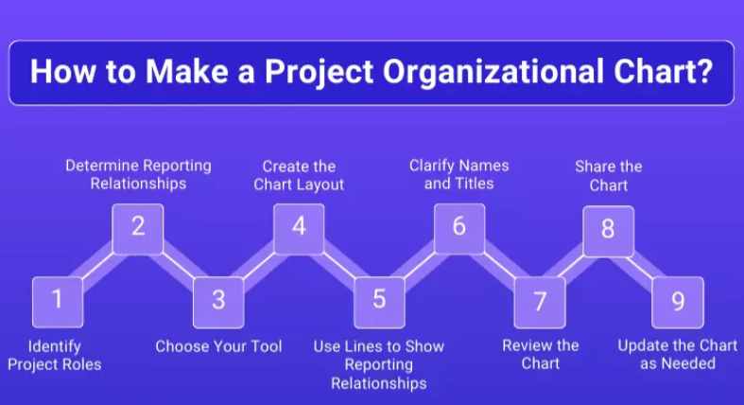
How to Make a Project Organizational Chart?
‍
Notes:
Creating a project organizational chart is an essential step in defining roles responsibilities, and reporting relationships within a project. It visually represents how the project team is structured, who is accountable for what, and how communication flows. Here's a step-by-step guide on how to create an effective project organizational chart:
‍
1. Identify Project Roles
The first step in creating a project organizational chart is to identify all the roles involved in the project. These roles vary based on the project's scope and complexity; still, typical roles include the Project Sponsor, who provides overall support and funding, and the Project Manager, who is responsible for planning, execution, and delivery. Other roles include Team Members, who handle specific tasks or work packages, and Functional Managers, who manage departments (such as IT, HR, and marketing) that contribute resources or expertise.
‍
‍Stakeholders (such as clients, senior executives, or other interested parties) are also important to identify, even if they aren't directly involved in the day-to-day activities. By defining these roles, you lay the foundation for structuring the chart and understanding the workflow and responsibilities of each team member.
‍
2. Determine Reporting Relationships
Once roles are defined, the next step is to establish how these roles interact and report to one another. The reporting relationships indicate who has authority over whom, and it ensures clarity in decision-making and communication. For example, the Project Manager typically reports to the Project Sponsor and is responsible for overseeing the project team.
‍
In some project structures (e.g., Matrix Structure), project team members may report both to the Project Manager and their respective Functional Managers, leading to a dual reporting line. In a Projectized Structure, the Project Manager usually has full authority over the project team. Establishing these reporting lines early helps ensure clarity about who is in charge of what and ensures that accountability is clear throughout the project.
‍
3. Choose Your Tool
There are a variety of tools available for creating a project organizational chart. The choice of tool largely depends on the size of the project, the complexity of the chart, and your preferred method of presentation. For simple charts, software like Microsoft PowerPoint, Excel, or Word can be used to create basic diagrams. However, for more professional or complex charts, tools like Lucidchart, Microsoft Visio, or Canva provide more advanced diagramming features, including drag-and-drop functionality and the ability to customize shapes and layouts.
‍
If you use Project Management Software (e.g., Asana, Monday.com, or Trello), these platforms sometimes offer built-in features to help visualize team roles and structures. Choosing the right tool helps streamline the chart-making process and ensures your chart is easy to read and update.
‍
4. Create the Chart Layout
Once you've chosen your tool, it's time to create the chart layout. The layout should follow a hierarchical structure, typically with the most senior roles at the top and lower-level team members underneath. In most project charts, the Project Sponsor is placed at the top, followed by the Project Manager, who oversees the project’s execution.
‍
Beneath the Project Manager, roles such as Functional Managers and Team Leads are placed, with individual Team Members appearing at the bottom of the hierarchy. For matrix structures, the chart may have overlapping lines to show that some team members report to both a Functional Manager and the Project Manager. The layout needs to be clear and easy to read, with enough space to ensure each role is easily distinguishable.
‍
5. Use Lines to Show Reporting Relationships
In an organizational chart, lines are used to represent reporting relationships and hierarchy visually. Solid lines typically indicate direct reporting lines, such as when a Team Member reports to a Project Manager or a Functional Manager. These lines show clear authority and responsibility, helping to map out the flow of control and communication.
‍
On the other hand, dotted lines can be used to represent secondary reporting relationships or advisory roles, as seen in matrix structures where team members may report to both a Project Manager and a Functional Manager. These lines clarify the relationships between different roles and help ensure that communication channels are well understood.
‍
6. Clarify Names and Titles
After setting up the basic structure and layout, each role in the organizational chart should be clearly labeled with both a title and, if necessary, the name of the person filling that role. For example, instead of just labeling a position as "Project Manager," it would be helpful to include the name of the person (e.g., "Project Manager – John Doe").
‍
This not only adds clarity but also helps team members quickly identify who holds which responsibility. Including names can also personalize the chart, making it more relevant to the team. This is particularly useful for larger teams or complex projects where multiple people may share similar titles or roles, ensuring that everyone knows who is responsible for what.
7. Review the Chart
Once the chart is created, it’s important to review it for accuracy. This involves checking that all relevant roles have been included and that the reporting lines and relationships are clearly represented. It’s also helpful to get feedback from key stakeholders, such as the Project Sponsor, Project Manager, or Functional Managers, to ensure that the chart accurately reflects the team structure.
‍
Reviewing the chart helps identify any gaps in the team, misrepresented roles, or confusion about reporting lines. By double-checking, you ensure the chart is not only accurate but also effective in guiding team members throughout the project lifecycle.
‍
8. Share the Chart
Once the chart has been finalized, it should be shared with all project team members and stakeholders. This ensures that everyone is on the same page regarding roles, responsibilities, and reporting relationships. Sharing the chart early in the project helps clarify expectations, streamline communication, and prevent misunderstandings.
‍
Depending on the project size and complexity, you can distribute the chart via email, upload it to a shared drive, or include it as part of project documentation on a collaborative platform. This way, team members always have easy access to the chart for reference throughout the project.
‍
9. Update the Chart as Needed
Throughout the life of the project, team roles and responsibilities may change due to factors like resource reallocation, team member turnover, or shifts in project scope. It’s essential to keep the organizational chart updated as these changes occur. An outdated chart can lead to confusion about who is responsible for which tasks, especially when new team members join or when a project undergoes structural changes.
‍
Regular updates ensure that the chart remains a useful and relevant tool for the team, and it helps maintain clarity regarding decision-making, authority, and accountability. Make sure to communicate any changes to the team promptly.

Slide 55
Impact of Organizational Structure on Project Management
The type of organizational structure you choose for your company will impact communication, resource allocation, decision-making, and project implementation.
Communication
Resource Allocation
Decision-Making
Project Implementation
Notes:
The type of organizational structure you choose for your company will impact communication, resource allocation, decision-making, and project implementation.
Communication: Organizational structure impacts how communication flows between teams and management. Flatter structures (i.e. projectized structures) often facilitate open communication and can allow for more direct and effective communication pathways, while hierarchical structures (i.e. functional structures) can hinder communication flow and lead to communication bottlenecks.
Resource Allocation: The structure impacts how resources are allocated across projects. Centralized structures allocate resources based on top-down decisions, while decentralized structures involve more input from lower levels. Additionally, matrix structures often struggle with resource allocation due to dual reporting by team members to both functional and project managers.
Decision-Making: Hierarchical structures (i.e. functional structures) may lead to delayed or slower decision-making due to multiple layers of approval, while flatter structures (i.e. projectized structures) often allow for faster and more agile decisions and greater adaptability.
Project Implementation: The type of structure can affect the efficiency of project execution. Projectized structures, for example, can streamline project implementation by dedicating resources to a specific project.

Slide 56
What is the Right Project Management Structure? (1/4)
At the organization level, the first question that needs to be asked is how important is project management to the success of the firm? What percentage of core work involves projects?
  If over 75% of work involves projects, then an organization should consider a fully projectized organization
  If an organization has both standard products and projects, then a matrix arrangement would appear to be appropriate.
  If an organization has very few projects, then a less formal arrangement is probably all that is required. Dedicated teams could be created on an as- needed basis and the organization could outsource project work.

Slide 57
What is the Right Project Management Structure? (2/4)
A second key question is resource availability. Remember, matrix evolved out of the necessity to share resources across multiple projects and functional domains while at the same time creating legitimate project leadership.
  For organizations that cannot afford to tie up critical personnel on individual projects, a matrix system would appear to be appropriate. An alternative would be to create a dedicated team but outsource project work when resources are not available internally.

Slide 58
What is the Right Project Management Structure? (3/4)
At the project level, the question is how much autonomy the project needs in order to be successfully completed. There are (7) factors that should influence the choice of project management structure:
  Size of project.
  Strategic importance.
  Novelty and need for innovation.
  Need for integration (number of departments involved).
  Environmental complexity (number of external interfaces).
  Budget and time constraints.
  Stability of resource requirements.

Slide 59
What is the Right Project Management Structure? (4/4)
The higher the levels of these seven factors, the more independence and authority the project manager and project team need to be successful.
This translates into using either a dedicated project team or a project matrix structure.
For example, these structures should be used for large projects that are strategically critical and are new to the company, thus requiring much innovation.
These structures would also be appropriate for complex, multidisciplinary projects that require input from many departments.

Slide 60
Factor | Functional Structure | Projectized Structure | Matrix Structure | Composite Structure
Project Complexity | Suitable for less complex projects. | Ideal for complex projects requiring full focus. | Good for projects needing collaboration across functions. | Flexible; adapts to project complexity.
Resource Availability | Resources are used within functional areas. | Resources fully dedicated to the project. | Shared resources across projects, optimizing usage. | Varies; tailored to resource needs.
Control and Authority | Functional managers hold primary authority. | Project managers have total authority. | Shared authority can lead to conflicts. | Varies; depends on project needs.
Communication | Limited between departments; hierarchical. | Direct and frequent communication within the project. | Requires clear communication channels. | Varies based on the structure used.
Decision-Making Speed | Slower due to hierarchical processes. | Faster due to focused project management. | Moderate speed; depends on authority balance. | Flexible; can be quick if structured correctly.
Flexibility and Adaptability | Less flexible; changes can be slow to implement. | Less adaptable once the project starts. | Moderate flexibility; can adapt based on needs. | Highly adaptable to project requirements.
Team Dynamics | Strong functional relationships; weaker project focus. | Strong team cohesion around project goals. | Mixed dynamics can create challenges. | Depends on the combination of structures used.
Suitable Industries | Common in manufacturing and operations. | Common in construction and large-scale projects. | Used in various industries, especially tech and consulting. | Applicable across sectors; tailored to needs.
Notes:
Summary
Functional Structure: Best for simpler projects with clear functional roles but may struggle with communication and adaptability.
Projectized Structure: Ideal for complex projects needing focused management, with quick decision-making but less flexibility once underway.
Matrix Structure: Balances authority and resource sharing, suitable for collaborative projects but may lead to conflicts and require clear communication.
Composite Structure: Flexible and adaptable, allowing for varying structures based on project needs but may introduce complexity.
Agile Structure: Highly flexible and collaborative, best suited for complex, rapidly changing projects, emphasizing continuous feedback and quick decision-making.
Choosing the right structure depends on the specific project requirements, organizational culture, and the desired level of flexibility and control.

Slide 61
Defining the Project

Slide 62
“We can control only what we have planned” Therefore,
Defining the project is the first step

Slide 63
1- Defining the Project Scope (1/2)
Project scope is a definition of the end result or mission of your project—a product or service for your client/customer.
The primary purpose is to define as clearly as possible the deliverable(s) in specific, tangible, and measurable terms for the end user or the customer.
The project scope definition is a document that will be published and used by the project owner and project participants for planning and measuring project success.

Slide 64
1- Defining the Project Scope (2/2)
The scope should be developed under the direction of the project manager, customer, and other significant stakeholders.
Approximately, 50% of the planning problems are related to unclear definition of scope and goals*.
* Study involving more than 1,400 project managers in the United States and Canada, Gobeli and Larson (1990)
27

Slide 65
Employing a Project Scope Checklist (1/5)
Project objective
Deliverables
Milestones
Technical requirements.
Limits and exclusions
Reviews with customer.
28

Slide 66
Employing a Project Scope Checklist (2/5)
Project objective:
  The project objective answers the questions of what, when, how much, and at times, where of the overall objective to meet your customer’s need(s).
  For example, develop a program that automatically translates verbal sentences in English to Russian. The project should be completed within three years at a cost not to exceed $1.5 million.
Deliverables:
  Define major deliverables — the expected, measurable outputs over the life of the project.
  For example, deliverables in the early design phase of a project might be a list of specifications. In the 2nd phase deliverables could be software coding and a technical manual. The next phase could be the prototype. The final phase could be final tests and approved software.
  Note: Deliverables and requirements are often used interchangeably.
29

Slide 67
Employing a Project Scope Checklist (3/5)
Milestones:
  It is a significant event in a project that occurs at a point in time.
  The milestone schedule shows only major segments of work; it represents first, rough-cut estimates of time, cost, and resources for the project.
  For example, testing complete and finished by July 1 of the same year.
Technical requirements:
  Technical requirements typically clarify either the deliverables or define the performance specifications.
  For example, a technical requirement for a personal computer might be the ability to accept 120-volt alternating current or 240-volt direct current without any adapters or user switches.
  Another well-known example is the ability of 911 emergency systems to identify the caller’s phone number and location of the phone.
30

Slide 68
Employing a Project Scope Checklist (4/5)
Limits and exclusions:
  The limits of scope should be defined. Failure to do so can lead to false expectations and to expending resources and time on the wrong problem.
  Examples of limits are:
    work on site is allowed only between the hours of 8:00 pm - 5:00 am.
    System maintenance and repair will be done only up to one month after final inspection.
    Client will be billed for additional training beyond that prescribed in the contract.
  Exclusions further define the boundary of the project by stating what is not included.
  Examples include:
    data will be collected by the client, not the contractor;
    A house will be built, but no landscaping or security devices added.
    Software will be installed, but no training given.
Reviews with customer:
Completion of the scope checklist ends with a review with your customer (internal or
external).
The main concern is the understanding and agreement to the whole document
between both parties to avoid claims or misunderstanding.
31

Slide 69
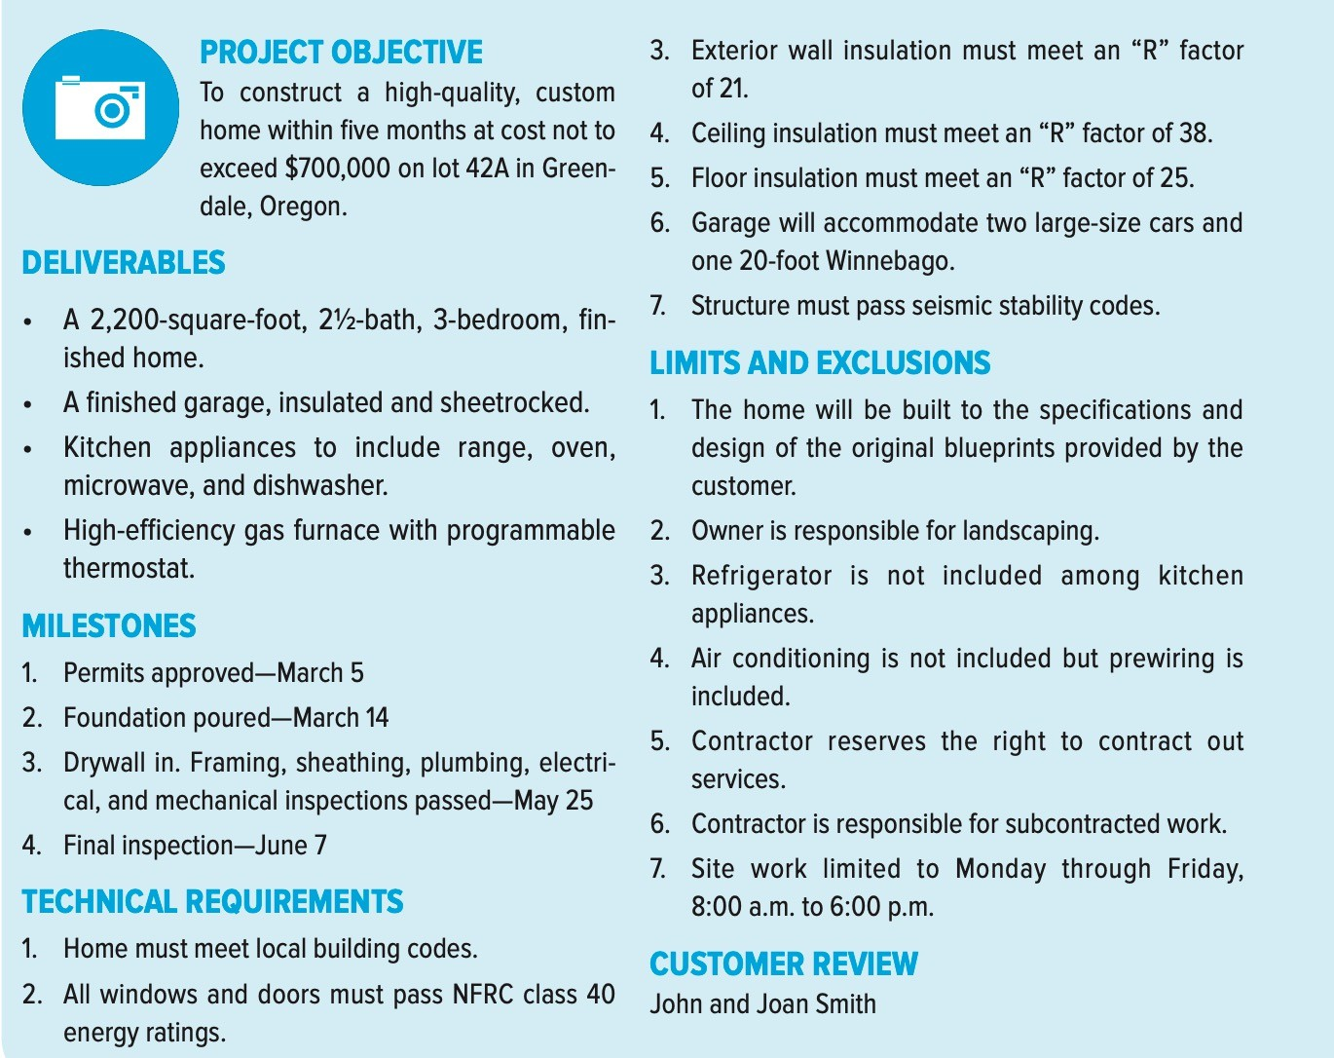
Employing a Project Scope Checklist (5/5)
Example

Slide 70
Assignment 2
What are the relative advantages and disadvantages of the functional, matrix, and dedicated team approaches to managing projects?
What distinguishes a weak matrix from a strong matrix?
Under what conditions would it be advisable to use a strong matrix instead of a dedicated project team?
What are the (6) elements of a typical scope statement?
What questions does a project objective answer?

Slide 71
Exercise 2
Define your project scope (per group).

Slide 72
Project guidelines (1/2)
Groups with (5) of Students / group (Week 2: Submitting Students group names and ID by mail).
Business idea (related to the electrical/computer engineering) → Week 3
Plagiarism (turnitin)
Divide the tasks/group
Numbers are important and its relation to practical life are important as well.
Search the internet seriously.

Slide 73
Project (Buisiness Plan) guidelines (2/2)
Each member is required to know every aspect of the project
Same writing style.
Follow the professional writing guidelines.
A report (15 – 20 pages) will be required.
Using Microsoft Project is a must (or at least Microsoft Excel) during the project preparation and it must be submitted with the report (pdf).

